Slide 1
Trường ĐH Sư Phạm Kỹ Thuật Tp. Hồ Chí Minh Khoa Đào tạo Chất lượng cao
Transfer from recognition to correspondence search
SV : Nguyễn Đình Quyền 15110115
Nguyễn T hiện Phú c 15110100
GVHD: Nguyễn Thiên Bảo

Slide 2


Nội dung
Task
Method
Results
Future work

Slide 3
Task
Low-level per-part correspondences between objects
Highly ambiguous matching problem
Examples: matching sound millisecond timestamps, image pixels

Slide 4
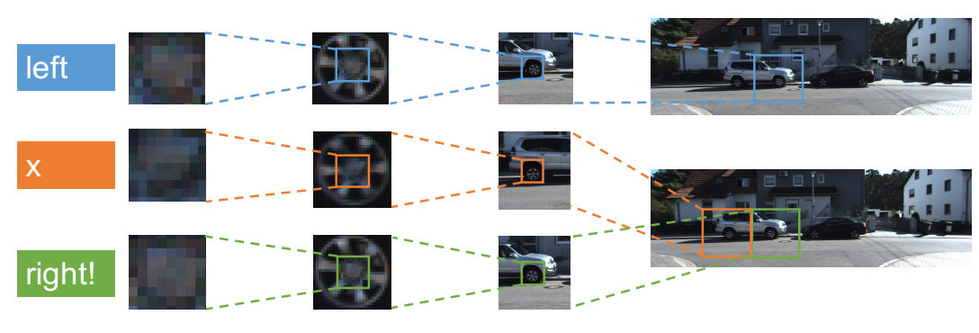
Task

Slide 5
Method
Neural paths are “matching” if activations are similar at all levels of CNN hierachy
Consider all the possible paths –exponential in number of leyers
But we propose a linear – time algorithm

Slide 6
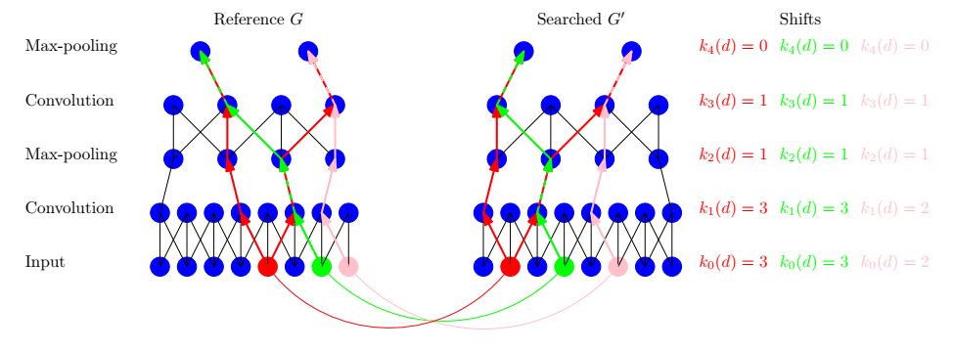
Method

Slide 7
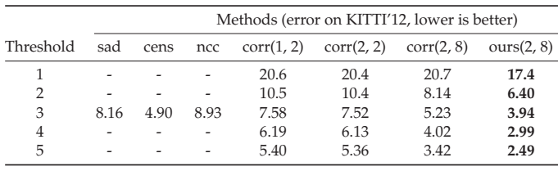
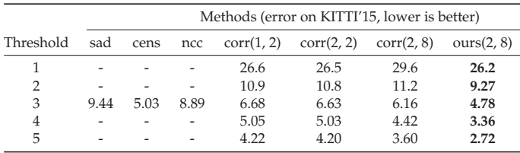
Results
STEREO MATCHING ON KITTI’12/15

Slide 8
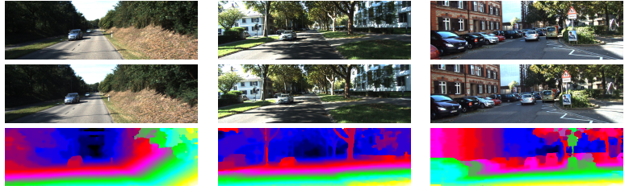
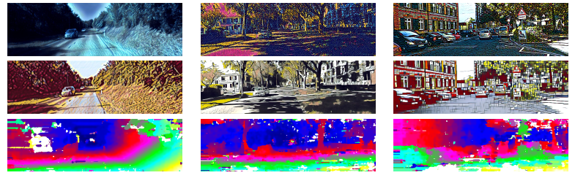
Results
Reference
Searched
Results
Reference
Searched
Results

Slide 9
Future work
Sound correspondences
Text correspondences (a few papers used convnets for texts)
Other correspondence tasks on grids

